Slide 1



Patel Electrical
WE MAKE
YOUR BUSINESS
BETTER THAN OTHERS
Government Approved Electrical Contractor
CONSULTING INSTALLATION TESTING MAINTENANCE MATERIAL SUPPLY
SOLAR ROOF TOP * SOLAR STREET LIGHT * SOLAR HIGH MAST

Slide 2
About Us
PATEL ELECTRICALS
Ensuring Constant blood flow in your is the doctor’s job, ensuring a constant power supply to your
industrial plants is ours. And we take our job seriously. We at Patel Electricals are a team of experienced
And enthusiastic professionals who ensure that your operation are safe, economic and efficient. Our core expertise lies in performing vital and reliable field service In the areas of electrical testing, commissioning, Maintenance and Consulting.
When your office of facility loses power for any reason, it’s more than an inconvenience. The longer you
Have power problems. The greater the chances that your sensitive equipment could become damaged or you could lose customers. There’s far too much riding on your building's power supply to trust and
Electrical service provider who won’t get out to fix the problem until the next morning, or after the weekend. It’s essential for you and your business that you work with an electrical service provider that is available 24 hours day, seven days a week. You expect the lights to turn on every time you flip the switch, so you should also expect your electrical service provider to be there every time you call. We’re having a sizeable Bench-strength of Trouble shooting, testing and maintenance Engineers – just like fire-Fighters, Who are really Waiting for a call !
Mob. No. 955-882-1250 / 960-127-3638
Email Id:- Patelelectrical17@gmail.com / earthlightingsolutions@gmail.com

Slide 3
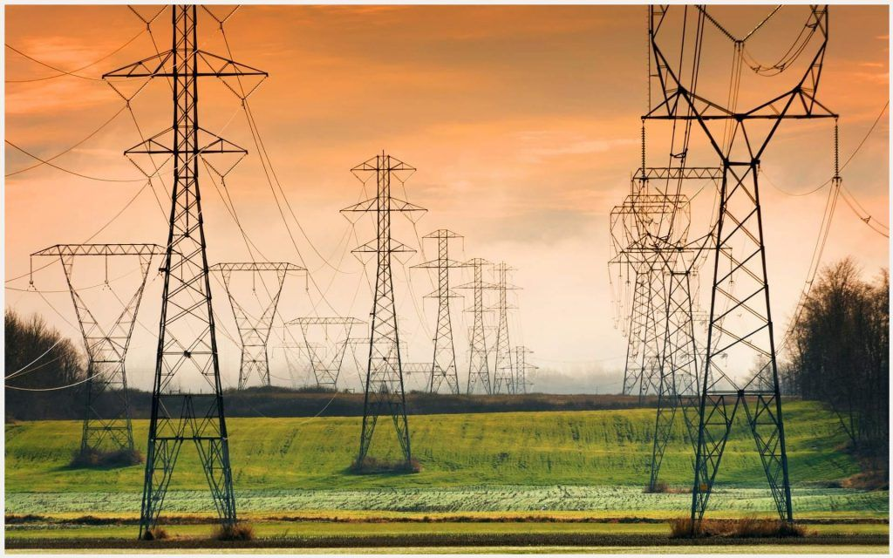
Our Mission
PATEL ELECTRICALS
In a Perfect world things wouldn't Breakdown. Until then, it is our mission to respond with urgency, expertise and professionalism to minimize the length and frequency of downtime.
We’re Committed to a high quality of workmanship and provide a safe work environment on all Projects. We know that people do business with companies that meet their needs and provide service. We attribute our success to building strategic partnership and treating costumers the way we want to be treated.
We believe the quality in our work will represent us for years to come.
Mob. No. 955-882-1250 / 960-127-3638
Email Id:- Patelelectrical17@gmail.com / earthlightingsolutions@gmail.com

Slide 4
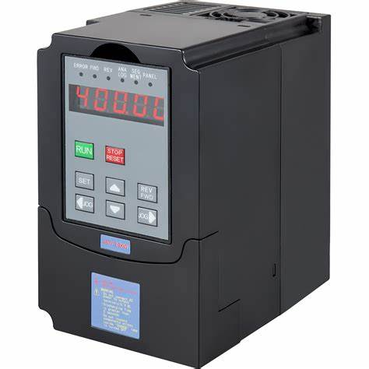
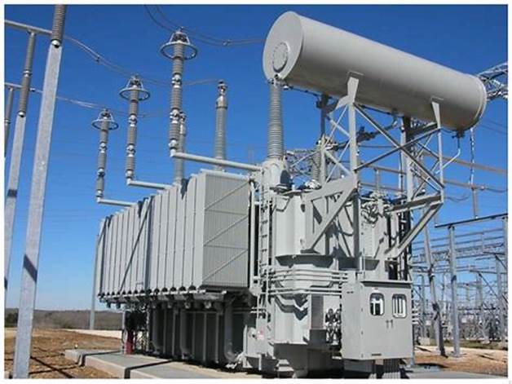
Design & Consulting Engineering
PATEL ELECTRICALS
Electrical Layout and System Design
Supply, Installation, Testing & Commissioning of Designed Schemes.
Application and Selection of Relays and Protective Relaying Schemes.
Power system Analysis, Short Circuit and relay Co-Ordination Studies.
Verification of Various Protective Relaying Schemes for Sensitivity and stability.
Power Factor Improvement Studies.
Transient Analysis of the Systems.
Harmonics Measurement, Analysis and Mitigation Techniques.
Thermal Imagine Graphic Scanning, Survey and Reports.
Mob. No. 955-882-1250 / 960-127-3638
Email Id:- Patelelectrical17@gmail.com / earthlightingsolutions@gmail.com

Slide 5
Field Testing, Maintenance & Engineering
Testing, Programming / Configuration of Relays of all Types & Makes.
Testing & Servicing / Overhauling of Indoor & Outdoor Circuit Breakers.
Testing of HT & LT Switchgear Panels, Transformers, Motors, Bus-ducts, Cables, etc.
Testing & Maintenance of Switchgear Equipment – LA, CT, PT, Isolator, CB, Transformer etc,
Complete Health Check-up and Maintenance of Indoor & Outdoor Switchgear Panel (PCC/MCC Panels, APFC Panels, VFD & Other LT & HT Switchboards)
Retrofitting Relays, Circuit Breakers.
Modification Renovation and Revamping of Switchgears.
Earth Pit & Earth Grid Resistance Measurement and Maintenance.
Cable Fault Location Jobs,
Testing & Verification of Systems as per AS-Built Drawings.
Supply & Installation of Relays, Circuit breakers, Obsolete Spares.
Meter Calibration
PATEL ELECTRICALS
Mob. No. 955-882-1250 / 960-127-3638
Email Id:- Patelelectrical17@gmail.com / earthlightingsolutions@gmail.com

Slide 6
Operation & Maintenance Service
Round the clock Deputation of Engineers / Technicians.
Early Restoration of Systems after Break-down.
Periodic Checks
General Maintenance.
PATEL ELECTRICALS
Erection and Installation
Transformers, HT & LT Switchgear Panel, Cable Trench / Tray, Earth Pit & Earthing.
Switchyard Equipment.
Cable Laying and Termination.
Fabrication related Work.
AMC Service / Breakdown Maintenance Service
Preventive Maintenance Service
Maintenance Service of Sub – Substation, HT/LT Panel, Motor.
Manpower Supply.
Emergency Support available 24/7.
Mob. No. 955-882-1250 / 960-127-3638
Email Id:- Patelelectrical17@gmail.com / earthlightingsolutions@gmail.com

Slide 7
Material Supply
PATEL ELECTRICALS
Industrial LED Weatherproof Lighting / Flameproof Light
Solar Street Light / Flood Light / High Mast Light
SERVICE
MEANS
SATISFACTIONS
Mob. No. 955-882-1250 / 960-127-3638
Email Id:- Patelelectrical17@gmail.com / earthlightingsolutions@gmail.com

